Slide 1
APTECH PROJECTS PRESENTATION

Slide 2
Hello, my name is Sinclair Amachree
And I’d like to show you a little bit of what I’ve been up to during my time at Aptech

Slide 3
What I Have Learned So Far
My time at Aptech has allowed to make great strides towards my dream of a career in software development. I have gained knowledge in various programming languages, and seen overall improvement as a developer.
So far I have gained experience with:
HTML/CSS, JavaScript, React, Bootstrap, SQL, JavaFX, Linux, C#, Flutter, etc.

Slide 4
My Projects

Slide 5
Bridges Website
As part of a team, I helped create a Bridges Website using ReactJS. Our website stored information for various bridges in a JSON file, presented them to the user along with with select images from a stored gallery, and allowed the user to filter the bridges on display.

Slide 6
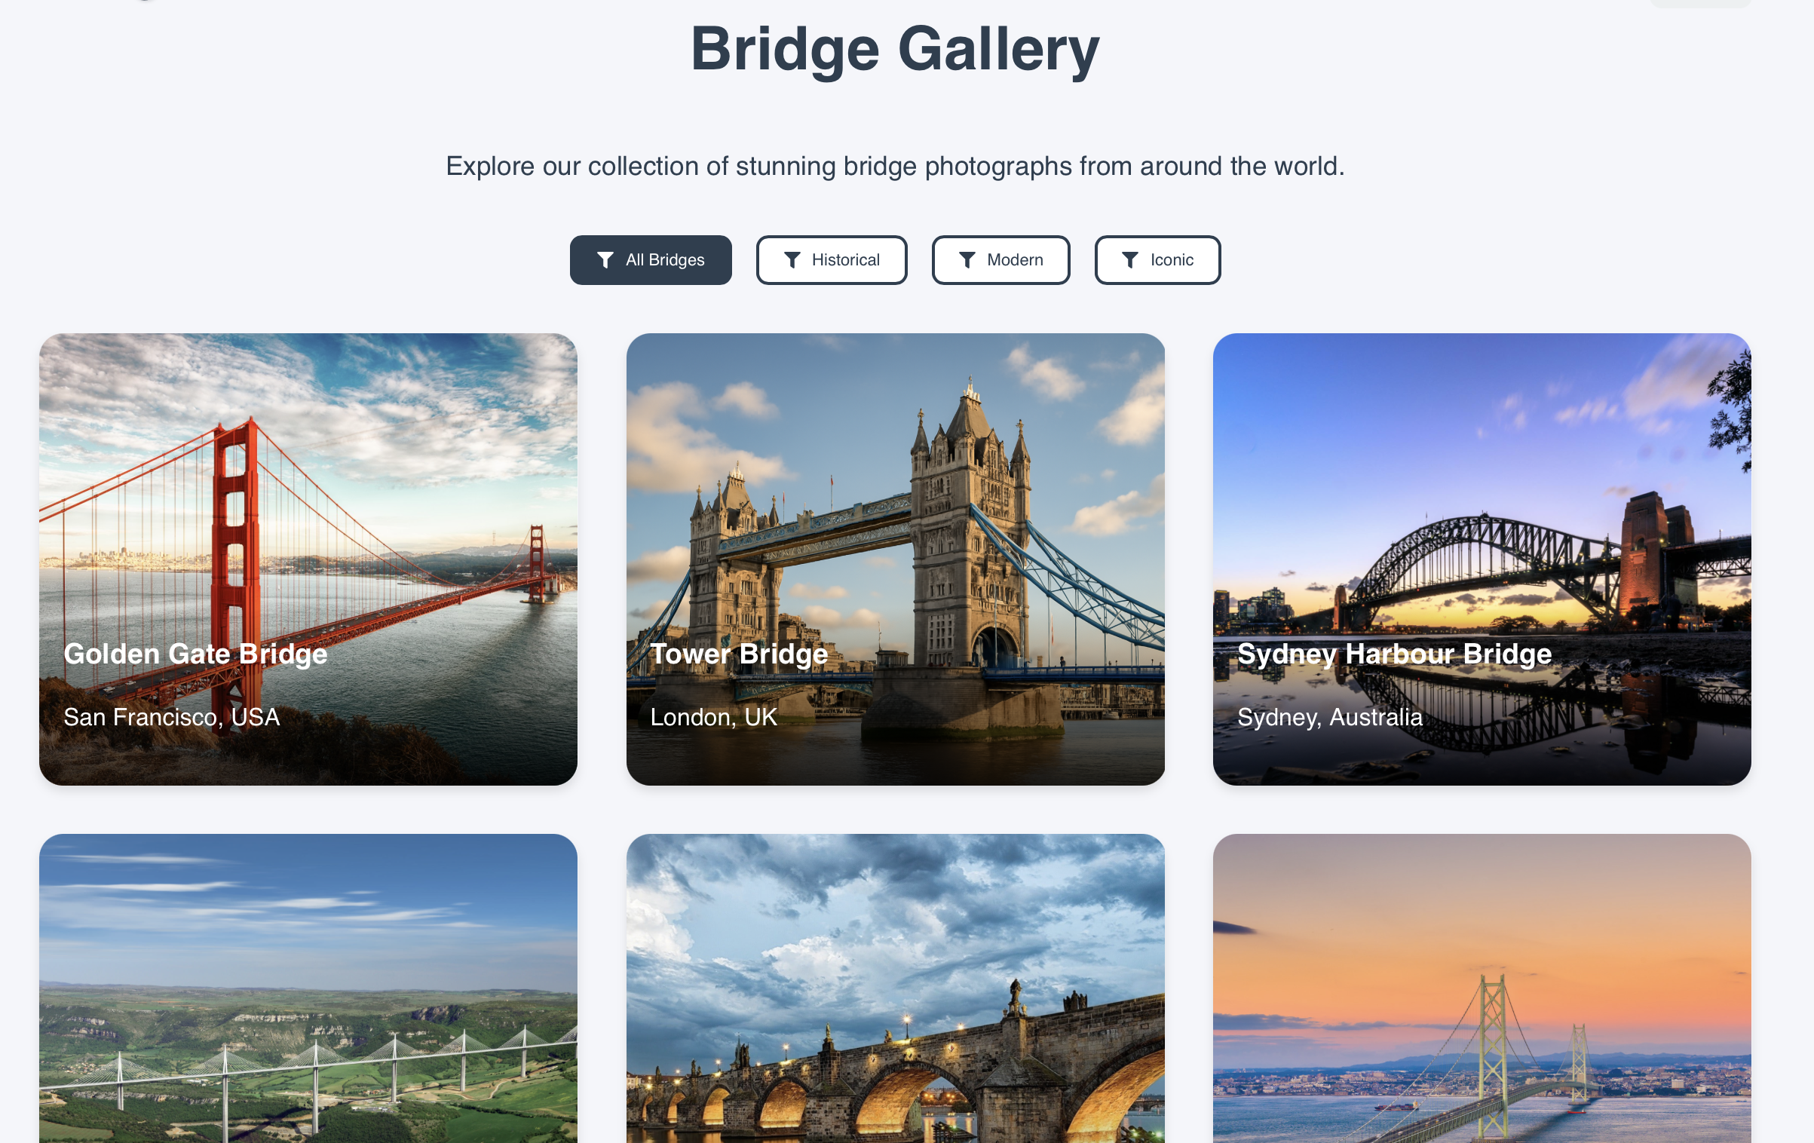
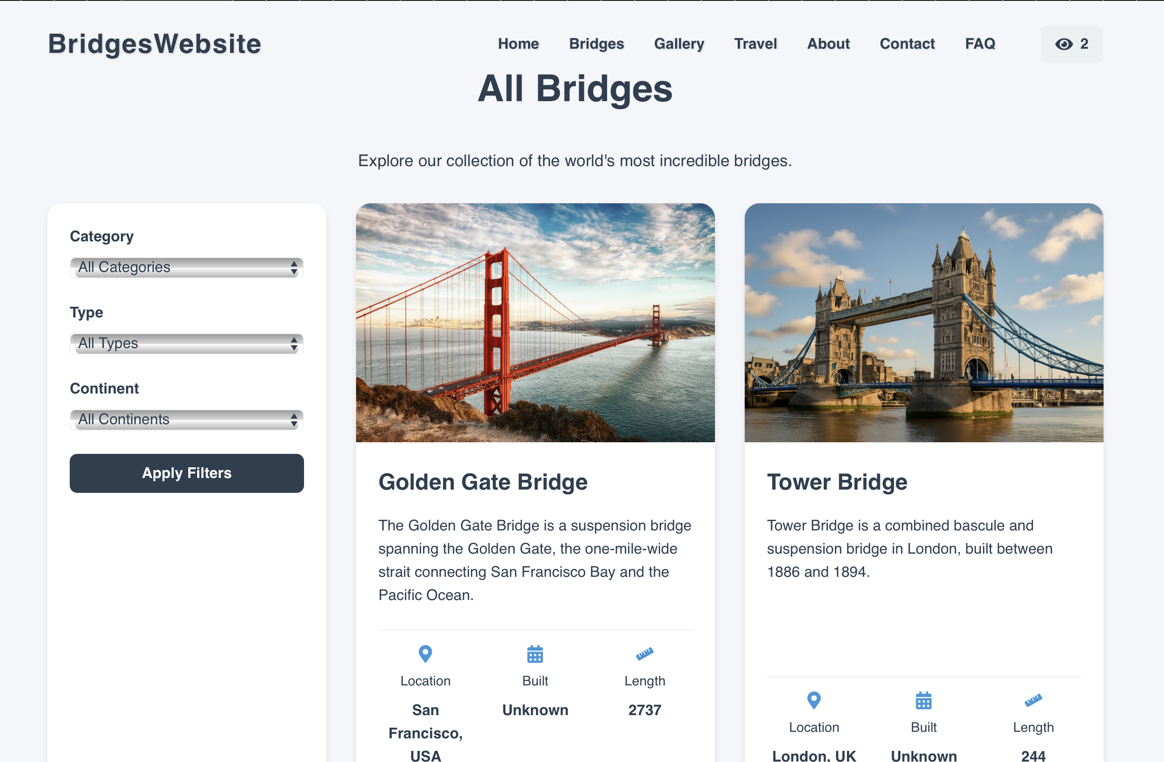
Bridges Site page presenting information stored in the JSON file with images from the gallery
Site Gallery

Slide 7
Vacancy Search Site
I created a simple Job Vacancy search site which allowed users to search for a specific job using keywords, and let them calculate their income for their chosen job. The site used JavaScript to search through a given Job Vacancies Database API, and to do the income calculations according to pre-selected parameters.

Slide 8
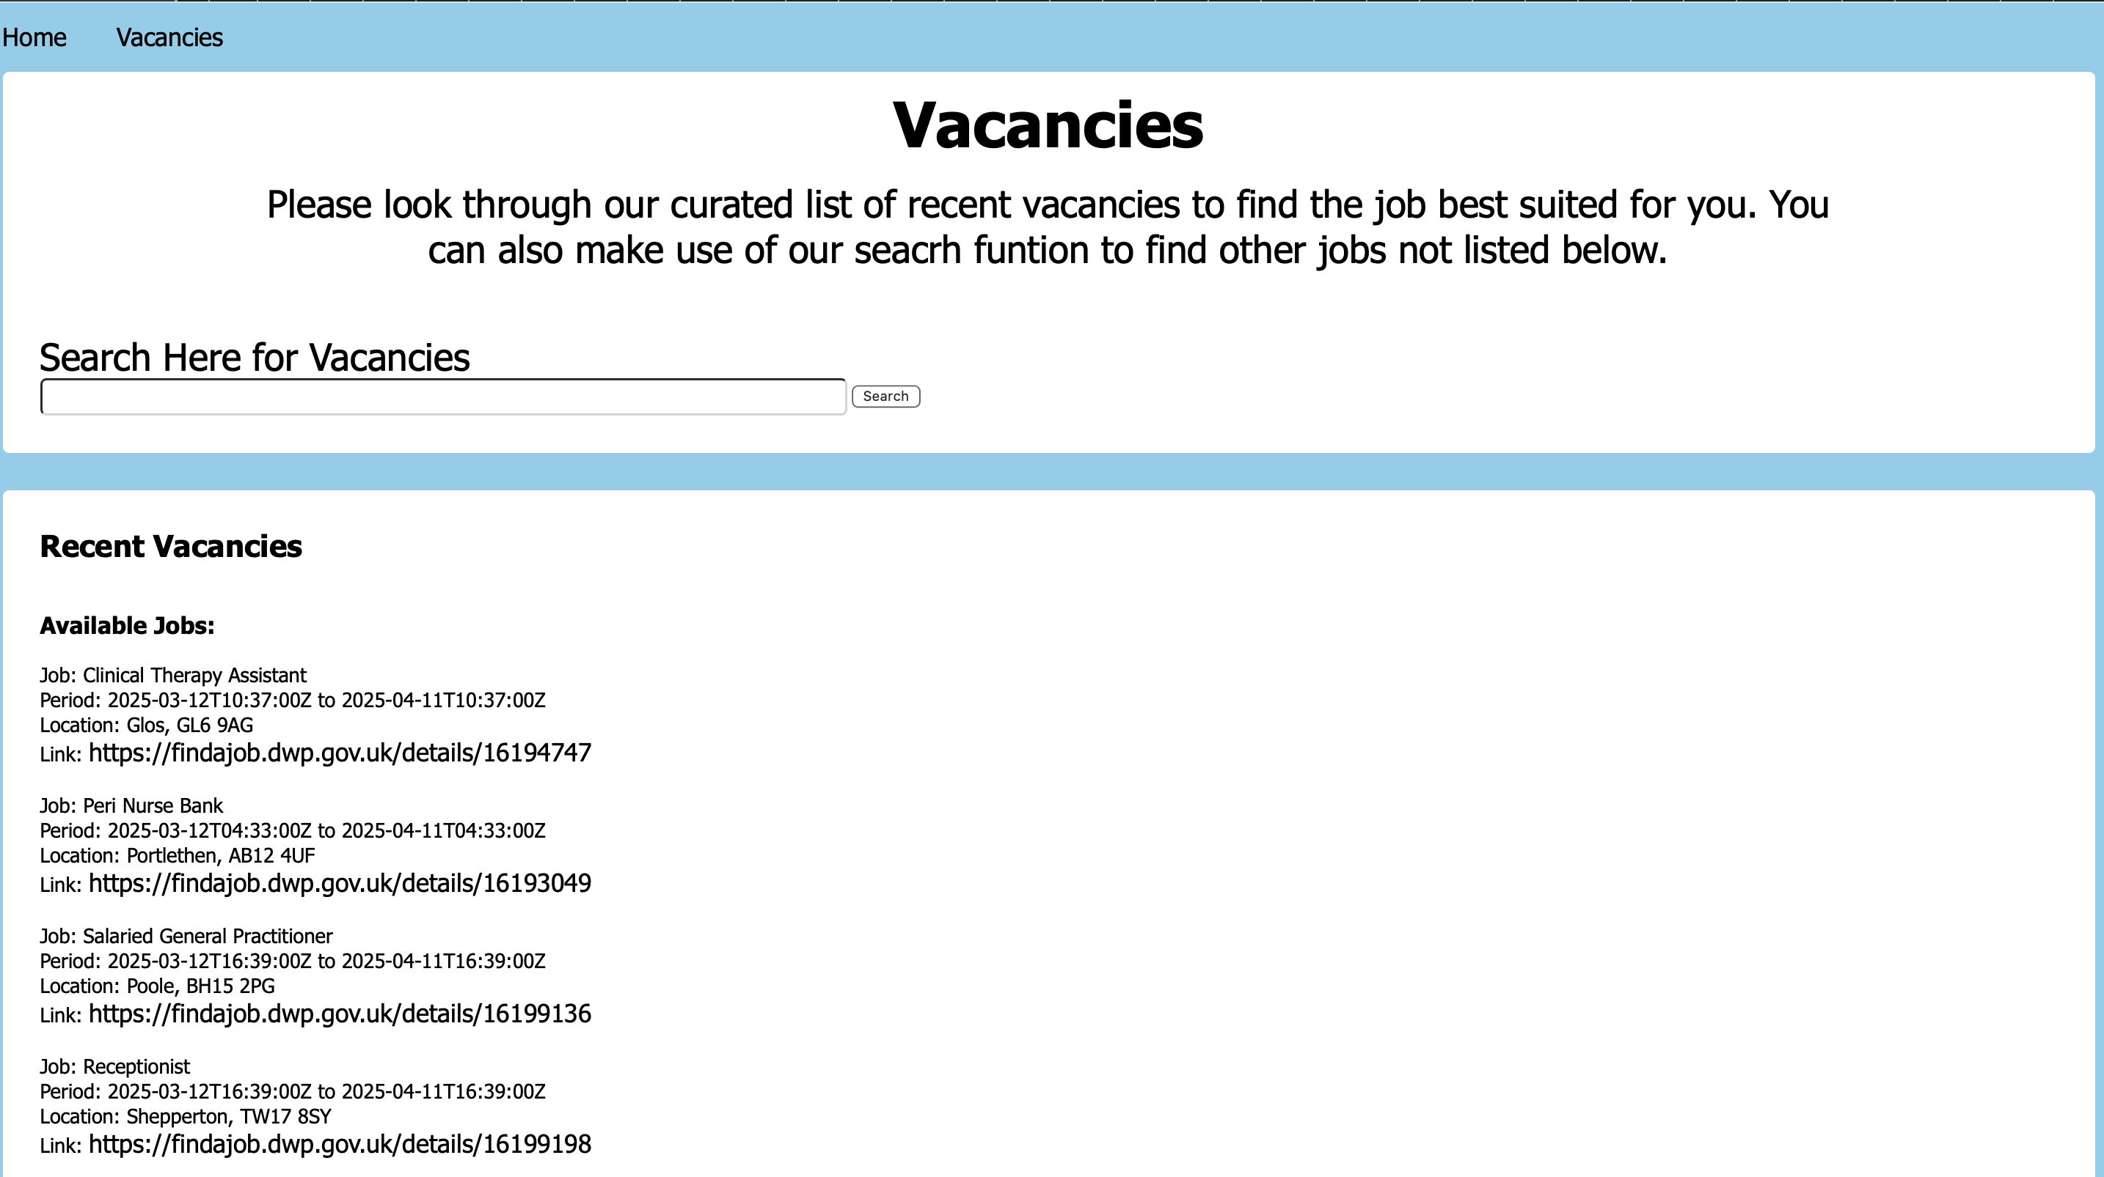
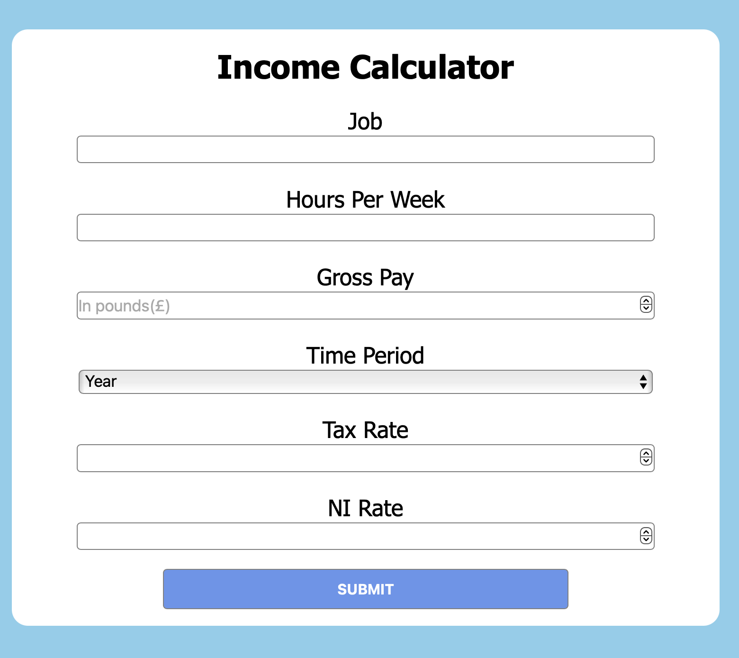
Income Calculator
The standard structure of the Vacancies listing page with recent vacancies listed and search bar.

Slide 9
Difficulties Encountered
Storing and reading information from a JSON file and implementing it in our React App.
Collaborating on a shared project through Git, cloning and distributing our site directory.
Working within a given deadline to meet design requirements
Adequately implementing API search functionality, and presenting the information to the user in a readable format.

Slide 10
What I Learned
I worked with new techniques and improved my overall knowledge of React and JavaScript.
I gained a better understanding of project design, through designing and implementing our site with other members of my group.
I worked as part of a design team improving my ability to collaborate with other developers.

